Slide 1
Classification: Basic Concepts and Decision Trees
Module B: AI and Machine Learning (Lecture:29-30)
Kazi Saeed Alam, Assistant Professor, Dept. of CSE, KUET
Email: saeed.alam@cse.kuet.ac.bd

Slide 2
Classification: Definition
Given a collection of records (training set )
  Each record contains a set of attributes, one of the attributes is the class.
Find a model for class attribute as a function of the values of other attributes.
Goal: previously unseen records should be assigned a class as accurately as possible.
  A test set is used to determine the accuracy of the model. Usually, the given data set is divided into training and test sets, with training set used to build the model and test set used to validate it.

Slide 3

Illustrating Classification Task

Slide 4




Examples of Classification Task
Predicting tumor cells as benign or malignant
Classifying credit card transactions
as legitimate or fraudulent
Classifying secondary structures of protein
as alpha-helix, beta-sheet, or random
coil
Categorizing news stories as finance,
weather, entertainment, sports, etc

Slide 5
Classification Techniques
Decision Tree
Neural Networks
Naïve Bayes
Bayesian Belief Networks
Support Vector Machines
Lazy Learners etc

Slide 6
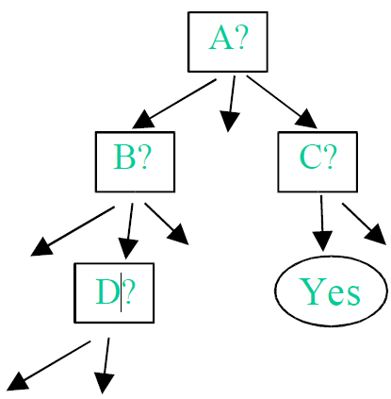
Decision Tree for Classification
Widely-used method of constructing a model from a dataset
    In the form of a decision tree or a set of decision rules. It is
Often claimed that this representation of the data has the advantage compared with other approaches of being meaningful and easy to interpret.

Slide 7
Decision Tree for Classification
A decision tree
  Internal node denotes a test on an attribute
  Branch denotes the outcome of the test
  Leaf node holds the class level
  The top most is the root node
  Internal nodes are represented by rectangles and leaf nodes by ovals
For a tuple X (class unknown),
  the attribute values are tested against the tree
  The path traced from root to leaf holds the class prediction for the tuple
  Can be found the classification rules

Slide 8
Decision Tree for Classification
Why popular
The construction decision tree needs no domain knowledge
Can handle multi dimensional data
Easy to assimilate by humans
Learning is simple and fast
Good accuracy (in general).
Many applications such as medicine, manufacturing, production, financial analysis, astronomy, molecular biology

Slide 9
Decision Tree Induction : Generation
Tree construction
  At start, all training examples at the root
  Partition examples based on selected attributes
  Test attributes are selected based on a heuristic or a statistical measure
Tree pruning
  Identify or remove branches that reflects noise or outliers

Slide 10

Example of a Decision Tree
categorical
categorical
continuous
class
Splitting Attributes
Refund
Yes
No
NO
MarSt
Single, Divorced
Married
TaxInc
NO
< 80K
> 80K
NO
YES
Training Data
Model: Decision Tree

Slide 11
Another Example of Decision Tree
categorical
categorical
continuous
class
MarSt
Single, Divorced
Married
NO
Refund
Yes
No
NO
TaxInc
< 80K
> 80K
NO
YES
There could be more than one tree that fits the same data!

Slide 12

Decision Tree Classification Task
Decision Tree

Slide 13

Apply Model to Test Data
Test Data
Start from the root of tree.
Refund
Yes
No
NO
MarSt
Single, Divorced
Married
TaxInc
NO
< 80K
> 80K
NO
YES

Slide 14
Apply Model to Test Data
Test Data
Refund
Yes
No
NO
MarSt
Single, Divorced
Married
TaxInc
NO
< 80K
> 80K
NO
YES

Slide 15

Apply Model to Test Data
Test Data
Refund
Yes
No
NO
MarSt
Single, Divorced
Married
TaxInc
NO
< 80K
> 80K
NO
YES

Slide 16
Apply Model to Test Data
Test Data
Refund
Yes
No
NO
MarSt
Single, Divorced
Married
TaxInc
NO
< 80K
> 80K
NO
YES

Slide 17

Apply Model to Test Data
Test Data
Refund
Yes
No
NO
MarSt
Single, Divorced
Married
TaxInc
NO
< 80K
> 80K
NO
YES

Slide 18
Apply Model to Test Data
Test Data
Refund
Yes
No
NO
MarSt
Single, Divorced
Married
Assign Cheat to “No”
TaxInc
NO
< 80K
> 80K
NO
YES

Slide 19

Decision Tree Classification Task
Decision Tree

Slide 20
Decision Tree Induction
Many Algorithms:
  Hunt’s Algorithm (one of the earliest)
  CART
  ID3, C4.5
  SLIQ,SPRINT

Slide 21
Algorithm for Decision Tree Induction
Basic algorithm (a greedy algorithm)
  Tree is constructed in a top-down recursive divide-and-conquer manner
  At start, all the training examples are at the root
  Attributes are categorical (if continuous-valued, they are discretized in advance)
  Examples are partitioned recursively based on selected attributes
  Test attributes are selected on the basis of a heuristic or statistical measure (e.g., information gain)

Slide 22
Algorithm for Decision Tree Induction
Conditions for stopping partitioning
  All samples for a given node belong to the same class
  There are no remaining attributes for further partitioning – majority voting is employed for classifying the leaf
  There are no samples left
Many variants
  ID3 , CHAID , CART , C4.5

Slide 23
Tree Induction
Greedy strategy.
  Split the records based on an attribute test that optimizes certain criterion.
Issues
  Determine how to split the records
    How to specify the attribute test condition?
    How to determine the best split?
  Determine when to stop splitting

Slide 24
Tree Induction
Greedy strategy.
  Split the records based on an attribute test that optimizes certain criterion.
Issues
  Determine how to split the records
    How to specify the attribute test condition?
    How to determine the best split?
  Determine when to stop splitting

Slide 25
How to Specify Test Condition?
Depends on attribute types
  Categorical
  Continuous
Depends on number of ways to split
  2-way split
  Multi-way split

Slide 26
Splitting Based on Categorical Attributes
Multi-way split: Use as many partitions as distinct values.
Binary split: Divides values into two subsets.
Need to find optimal partitioning.
What about this split?
Size
Small
Large
Medium
Size
Size
{Small, Medium}
OR
{Medium,
Large}
{Large}
{Small}
Size
{Small, Large}
{Medium}

Slide 27
Splitting Based on Continuous Attributes
Different ways of handling
  Discretization to form an ordinal categorical attribute
    Static – discretize once at the beginning
    Dynamic – ranges can be found by equal interval bucketing, equal frequency bucketing
    (percentiles), or clustering.
  Binary Decision: (A < v) or (A ≥ v)
    consider all possible splits and finds the best cut
    can be more compute intensive

Slide 28
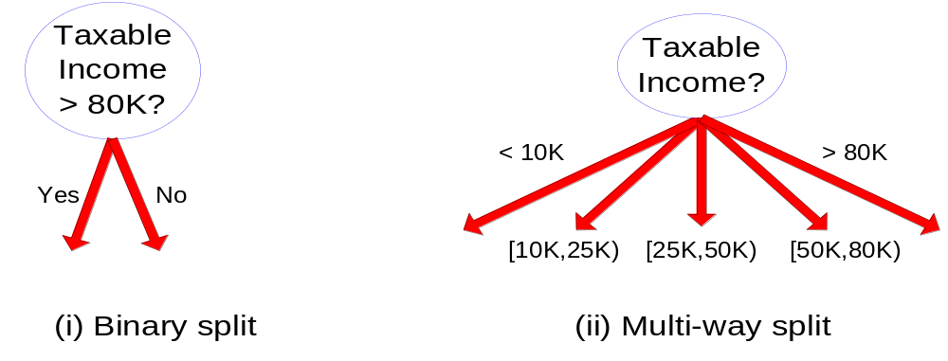
Splitting Based on Continuous Attributes

Slide 29
Tree Induction
Greedy strategy.
  Split the records based on an attribute test that optimizes certain criterion.
Issues
  Determine how to split the records
    How to specify the attribute test condition?
    How to determine the best split?
  Determine when to stop splitting

Slide 30
Attribute Selection Measure
  Information Gain
  Gain Ratio
  Gini Index

Slide 31
Attribute Selection Measure
Information gain (ID3/C4.5)
  All attributes are assumed to be categorical
  Can be modified for continuous-valued attributes
Gini index (IBM IntelligentMiner)
  All attributes are assumed continuous-valued
  Assume there exist several possible split values for each attribute
  May need other tools, such as clustering, to get the possible split values
  Can be modified for categorical attributes
Chapter 6

Slide 32

Attribute Selection Measure: Information Gain (ID3/C4.5)
Select the attribute with the highest information gain
Expected information (entropy) needed to classify a tuple in D:
p_{i} = the number of occurrences of class i divided by the total number of instances
i = 1…k
k = Number of class

Slide 33


Attribute Selection Measure: Information Gain (ID3/C4.5)
Information needed (after using A to split D into v partitions) to classify D:
Information gained by branching on attribute A

Slide 34
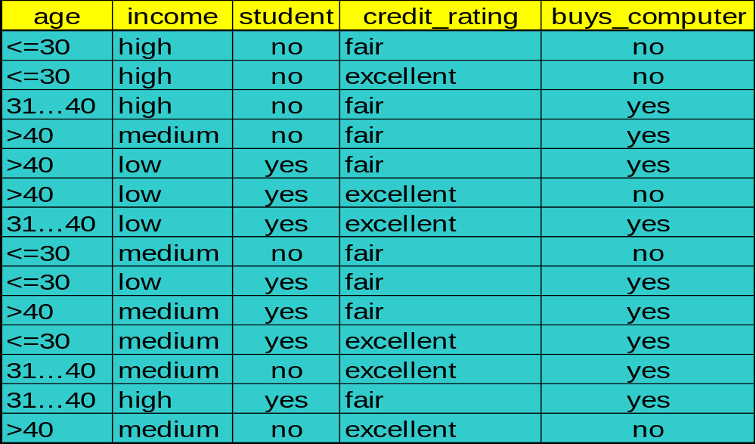
Training Set for buys_computer Example

Slide 35
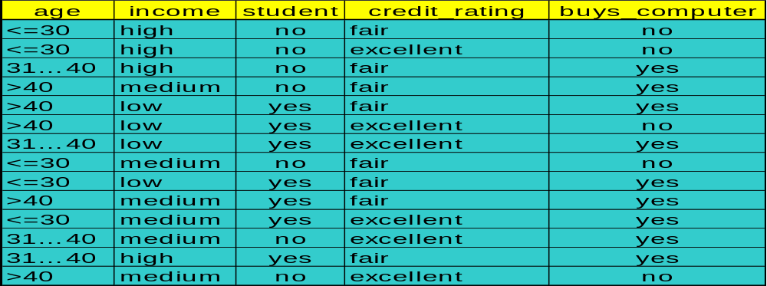
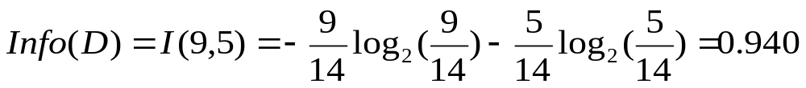
Attribute Selection : Information Gain

Slide 36



Attribute Selection: Information Gain
means “age <=30” has 5 out of 14 samples, with 2 yes’es and 3 no’s.
Similarly,

Slide 37
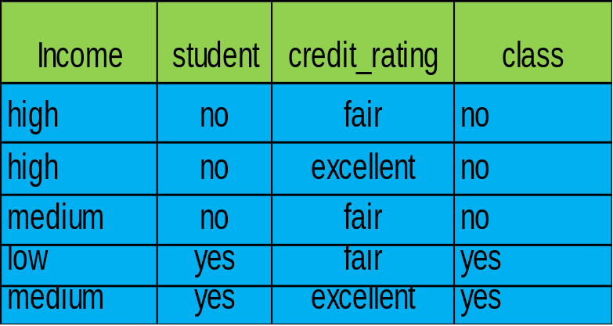
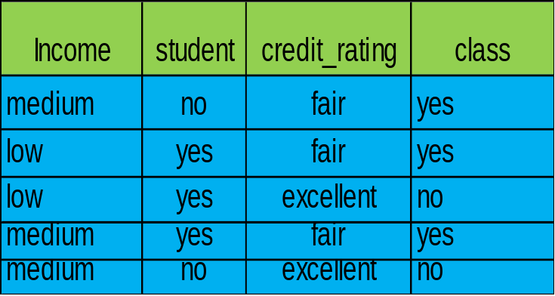
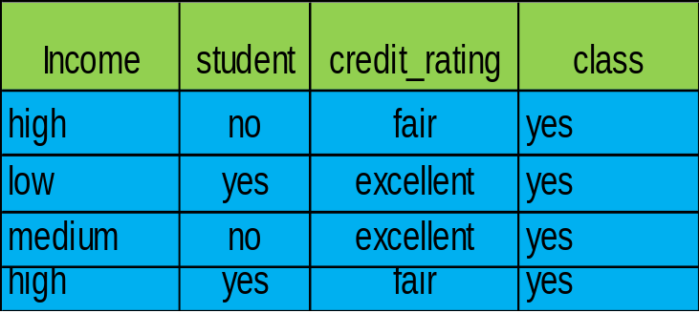
Attribute Selection : Information Gain
Age?
>40
<=30
31…40

Slide 38
Output: A Decision Tree for “buys_computer”
age?
<=30
overcast
>40
31..40
student?
yes
credit rating?
no
yes
fair
excellent
no
yes
no
yes
Data Mining: Concepts and Techniques

Slide 39
Attribute Selection : Information Gain
(Continuous Valued Attribute)
Let attribute A be a continuous-valued attribute
Must determine the best split point for A
  Sort the value A in increasing order
  Typically, the midpoint between each pair of adjacent values is considered as a possible split point
    (a_{i}+a_{i+1})/2 is the midpoint between the values of a_{i} and a_{i+1}
  The point with the minimum expected information requirement for A is selected as the split-point for A
Split:
  D1 is the set of tuples in D satisfying A ≤ split-point, and D2 is the set of tuples in D satisfying A > split-point

Slide 40
Extracting Classification Rules from Trees
Represent the knowledge in the form of IF-THEN rules
One rule is created for each path from the root to a leaf
Each attribute-value pair along a path forms a conjunction
The leaf node holds the class prediction
Rules are easier for humans to understand
Chapter 6

Slide 41
  IF age = “<=30” AND student = “no” THEN buys_computer = “no”
  IF age = “<=30” AND student = “yes” THEN buys_computer = “yes”
  IF age = “31…40” THEN buys_computer = “yes”
  IF age = “>40” AND credit_rating = “excellent” THEN buys_computer = “yes”
  IF age = “<=30” AND credit_rating = “fair” THEN buys_computer = “no”
age?
<=30
>40
30..40
student?
yes
credit rating?
no
yes
excellent
fair
no
yes
no
yes

Slide 42
Training Examples
Day
Outlook
Temp.
Humidity
Wind
Play Tennis
D1
Sunny
Hot
High
Weak
No
D2
Sunny
Hot
High
Strong
No
D3
Overcast
Hot
High
Weak
Yes
D4
Rain
Mild
High
Weak
Yes
D5
Rain
Cool
Normal
Weak
Yes
D6
Rain
Cool
Normal
Strong
No
D7
Overcast
Cool
Normal
Weak
Yes
D8
Sunny
Mild
High
Weak
No
D9
Sunny
Cold
Normal
Weak
Yes
D10
Rain
Mild
Normal
Strong
Yes
D11
Sunny
Mild
Normal
Strong
Yes
D12
Overcast
Mild
High
Strong
Yes
D13
Overcast
Hot
Normal
Weak
Yes
D14
Rain
Mild
High
Strong
No

Slide 43
Attribute Selection : Gain Ratio
Information gain measure is biased towards attributes with a large number of values
C4.5 (a successor of ID3) uses gain ratio to overcome the problem (normalization to information gain)

Slide 44
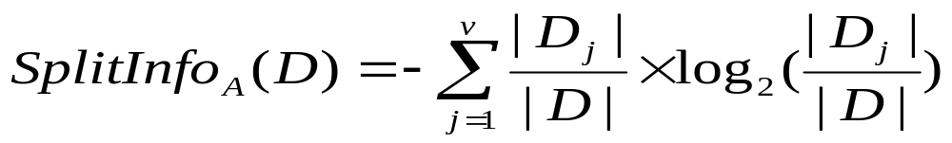
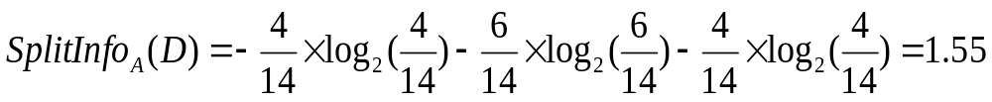
Attribute Selection : Gain Ratio
  GainRatio(A) = Gain(A)/SplitInfo(A)
Ex.
  gain_ratio(income) = 0.029/0.926 = 0.019
The attribute with the maximum gain ratio is selected as the splitting attribute

Slide 45
Random Forest, Ensemble Model
The random forest (Breiman, 2001) is an ensemble approach that can also be thought of as a form of nearest neighbor predictor.
Ensembles are a divide-and-conquer approach used to improve performance. The main principle behind ensemble methods is that a group of “weak learners” can come together to form a “strong learner”.

Slide 46
Trees and Forests
The random forest starts with a standard machine learning technique called a “decision tree” which, in ensemble terms, corresponds to our weak learner. In a decision tree, an input is entered at the top and as it traverses down the tree the data gets bucketed into smaller and smaller sets.

Slide 47
Random Forest
We build a number of decision trees on bootstrapped training samples each time a split in a tree is considered, a random sample of m predictors is chosen as split candidates from the full set of p predictors.

Slide 48
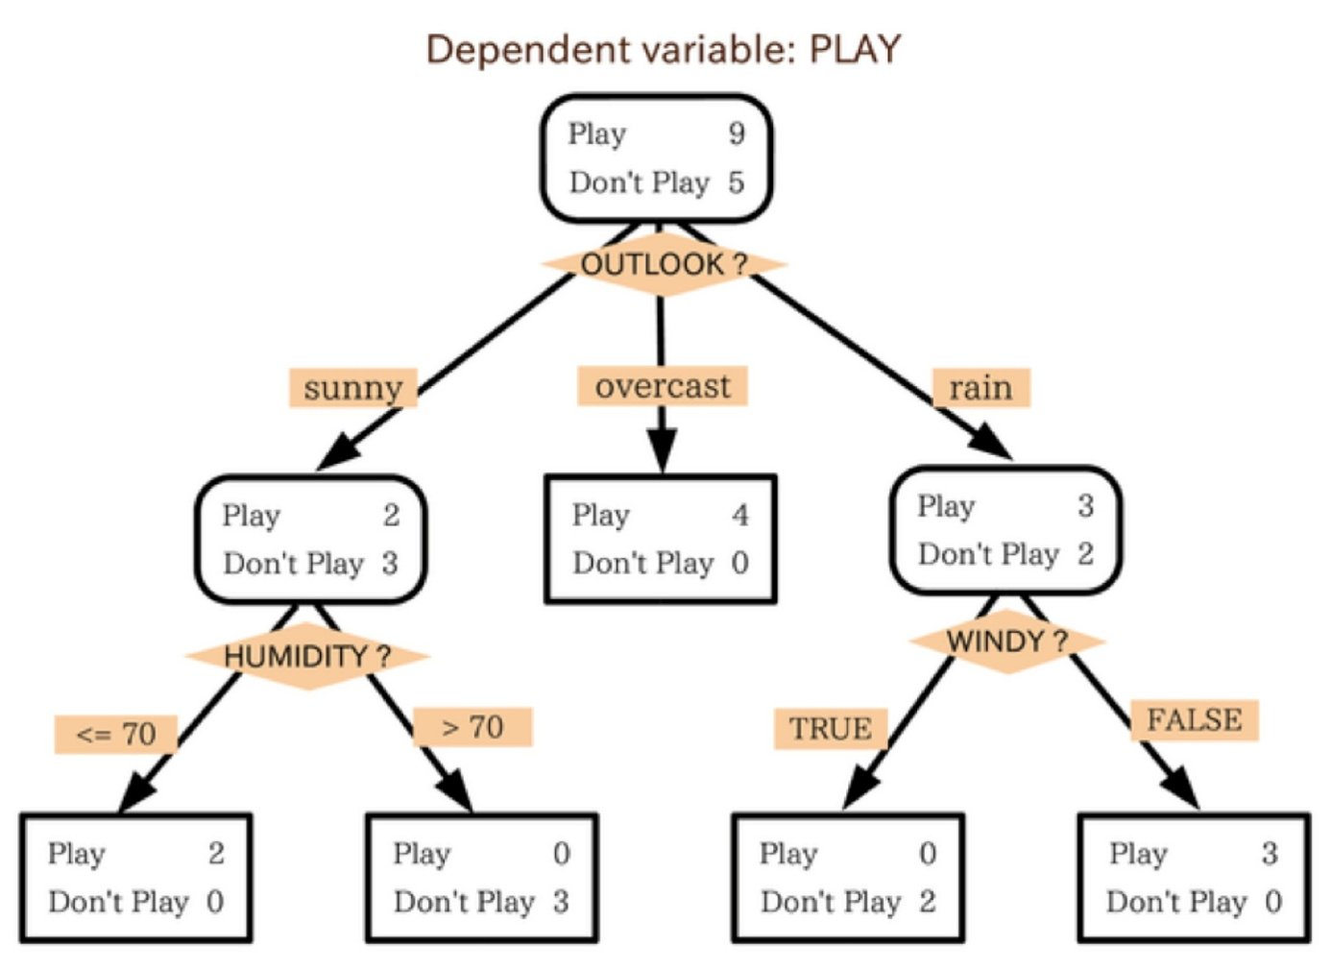
Trees and Forests
In this example, the tree advises us, based upon weather conditions, whether to play ball. For example, if the outlook is sunny and the humidity is less than or equal to 70, then it’s probably OK to play.

Slide 49
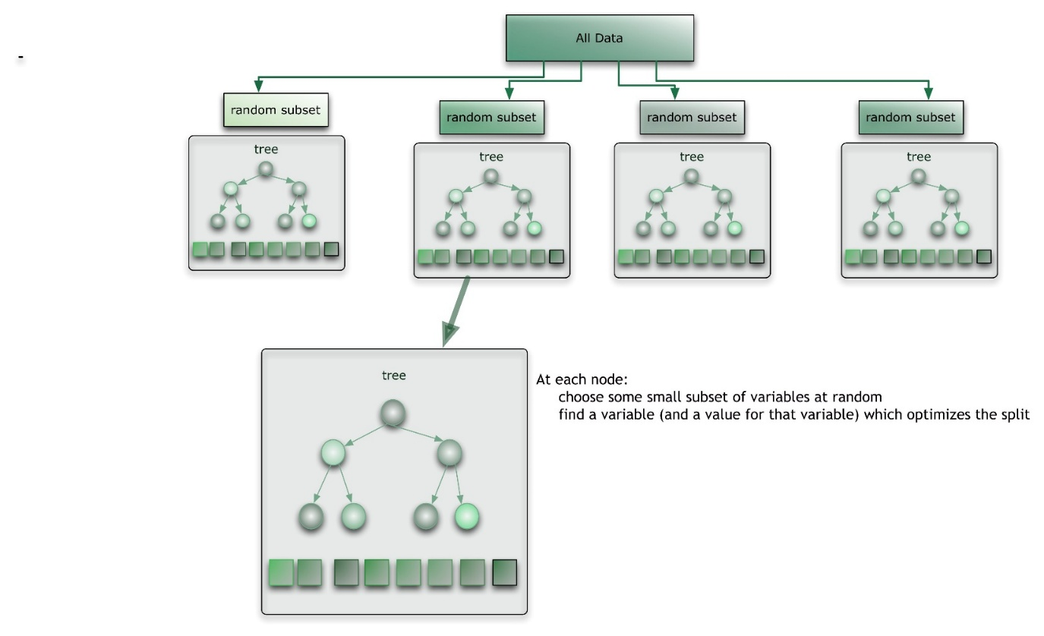
Trees and Forests
The random forest takes this notion to the next level by combining trees with the notion of an ensemble. Thus, in ensemble terms, the trees are weak learners and the random forest is a strong learner.

Slide 50
Random Forest Algorithm
For b = 1 to B:
Draw a bootstrap sample Z∗ of size N from the training data.
(b) Grow a random-forest tree to the bootstrapped data, by recursively repeating the following steps for each terminal node of the tree, until the minimum node size n_{min} is reached.
Select m variables at random from the p variables.
Pick the best variable/split-point among the m.
Split the node into two daughter nodes. Output the ensemble of trees.

Slide 51
Random Forest Algorithm
To make a prediction at a new point x we do:
→ For regression: average the results
→ For classification: majority vote

Slide 52
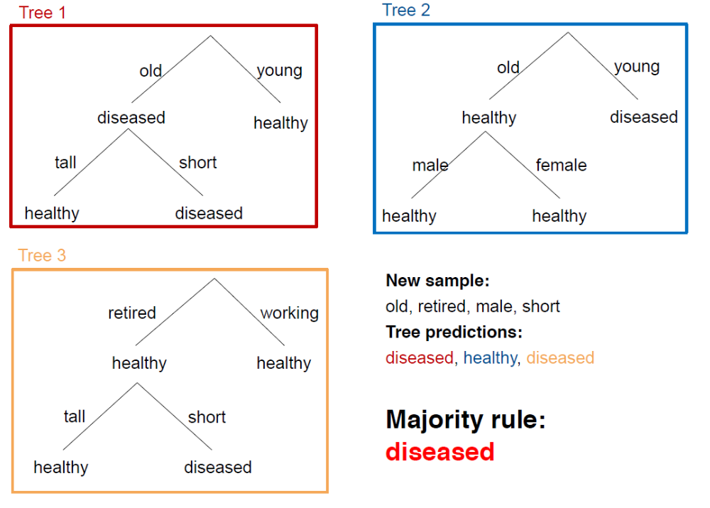

Slide 53
Running a Random Forest
When a new input is entered into the system, it is run down all of the trees. The result may either be an average or weighted average of all of the terminal nodes that are reached, or, in the case of categorical variables, a voting majority.
Note that:
With a large number of predictors, the eligible predictor set will be quite different from node to node.
The greater the inter-tree correlation, the greater the random forest error rate, so one pressure on the model is to have the trees as uncorrelated as possible.

Slide 54
Differences to standard tree
Train each tree on Bootstrap Resample of data (Bootstrap resample of data set with N samples: Make new data set by drawing with Replacement N samples; i.e., some samples will probably occur multiple times in new data set)
For each split, consider only m randomly selected variables
Don’t prune
Fit B trees in such a way and use average or majority voting to aggregate results

Slide 55
Random Forests Tuning
The inventors make the following recommendations:
→ For classification, the default value for m is √p and the minimum node size is one.
→ For regression, the default value for m is p/3 and the minimum node size is five.
In practice the best values for these parameters will depend on the problem, and they should be treated as tuning parameters.
Like with Bagging, we can use OOB and therefore RF can be fit in one sequence, with cross-validation being performed along the way. Once the OOB error stabilizes, the training can be terminated.

Slide 56
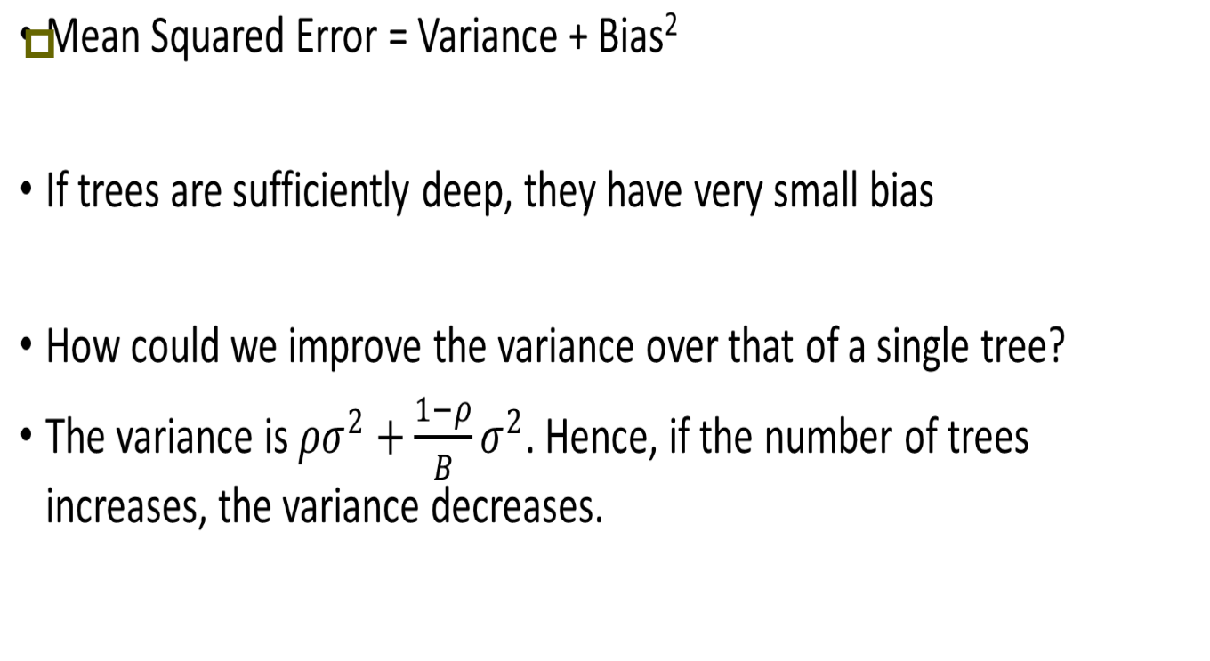
Why Random Forests works:

Slide 57
Advantages of Random Forest
No need for pruning trees
Accuracy and variable importance generated automatically
Overfitting is not a problem
Not very sensitive to outliers in training data
Easy to set parameters
Good performance

